Slide 1
Digital Circuit Design
18B11EC215
Lecture 6
Boolean Algebra and Logic Gates

Slide 2
Outline
Precedence of Operators
Truth Table & Proofs
Duality
Basic Theorems of Boolean Algebra
Boolean Functions
Complement of Functions
Logic Gates
Drawing Logic Circuit
Analysing Logic Circuit

Slide 3
Precedence of Operators[1]
To lessen the brackets used in writing Boolean expressions, operator precedence can be used.
Precedence (highest to lowest): ' . +
Examples:
a . b + c = (a . b) + c
b' + c = (b') + c
a + b' . c = a + ((b') . c)
Use brackets to overwrite precedence.
Examples: a . (b + c)
(a + b)' . c

Slide 4
Duality[1,2,3]
Duality Principle – every valid Boolean expression (equality) remains valid if the operators and identity elements are interchanged, as follows:
+ ↔ .
1 ↔ 0
Example: Given the expression
a + (b.c) = (a+b).(a+c)
then its dual expression is
a . (b+c) = (a.b) + (a.c)
Duality gives free theorems – “two for the price of one”. You prove one theorem and the other comes for free!
If (x+y+z)' = x'.y.'z' is valid, then its dual is also valid:
(x.y.z)' = x'+y'+z’

Slide 5
Basic Theorems of Boolean Algebra[1,2,3]
Apart from the axioms/postulates, there are other useful theorems.
1. Idempotency.
(a) x + x = x (b) x . x = x
Proof of (a):
x + x = (x + x).1 (identity)
= (x + x).(x + x') (complementarity)
= x + x.x' (distributivity)
= x + 0 (complementarity)
= x (identity)

Slide 6
Basic Theorems of Boolean Algebra contd..
2. Null elements for + and . operators.
(a) x + 1 = 1 (b) x . 0 = 0
3. Involution. (x')' = x
4. Absorption.
(a) x + x.y = x (b) x.(x + y) = x
5. Absorption (variant).
(a) x + x'.y = x+y (b) x.(x' + y) = x.y

Slide 7
Basic Theorems of Boolean Algebra contd..
6. De Morgan.
(a) (x + y)' = x'.y'
(b) (x.y)' = x' + y'
7. Consensus.
(a) x.y + x'.z + y.z = x.y + x'.z
(b) (x+y).(x'+z).(y+z) = (x+y).(x'+z)

Slide 8
Basic Theorems of Boolean Algebra [1]
Theorems can be proved using the truth table method.
They can also be proved by algebraic manipulation using axioms/postulates or other basic theorems.

Slide 9
Basic Theorems of Boolean Algebra[1]
Theorem 4a (absorption) can be proved by:
x + x.y = x.1 + x.y (identity)
= x.(1 + y) (distributivity)
= x.(y + 1) (commutativity)
= x.1 (Theorem 2a)
= x (identity)
By duality, theorem 4b:
x.(x+y) = x

Slide 10
Boolean Functions[1]
Boolean function is an expression formed with binary variables, the two binary operators, OR and AND, and the unary operator, NOT, parenthesis and the equal sign.
Its result is also a binary value.
We usually use . for AND, + for OR, and ' or ¬ for NOT. Sometimes, we may omit the . if there is no ambiguity.

Slide 11
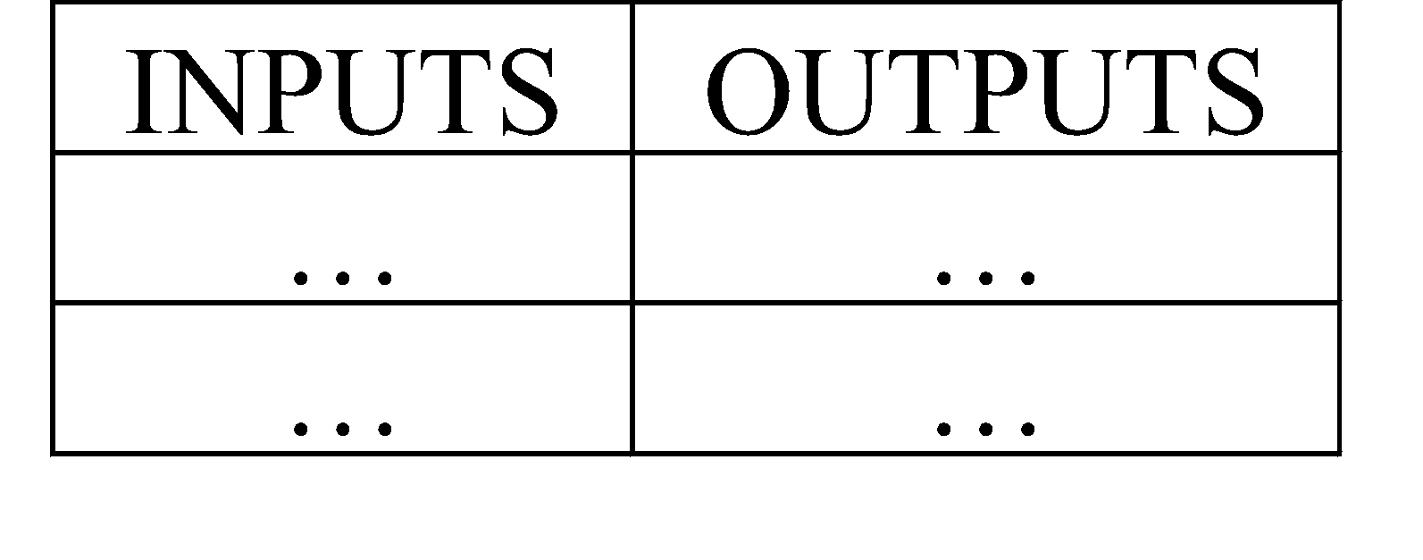
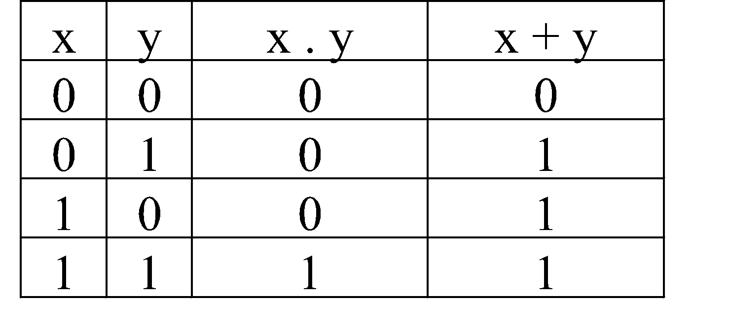
Truth Table[1]
Provides a listing of every possible combination of inputs and its corresponding outputs.
Example (2 inputs, 2 outputs):

Slide 12
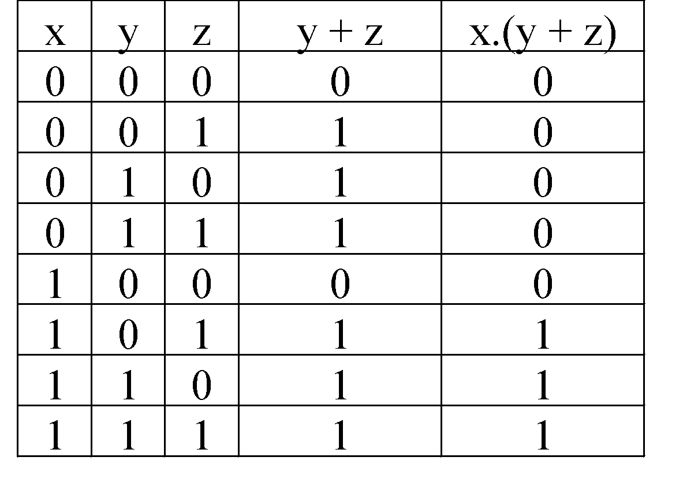
Truth Table
Example (3 inputs, 2 outputs):

Slide 13
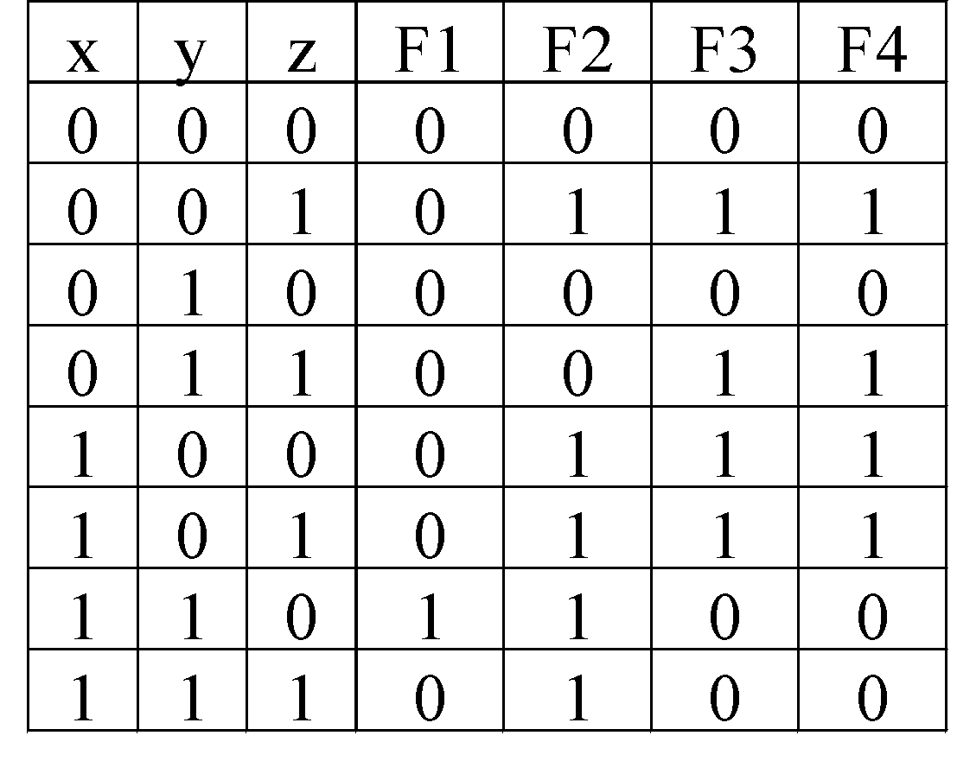
Boolean Functions
Examples:
F1= x.y.z'
F2= x + y'.z
F3=(x'.y'.z)+(x'.y.z)+(x.y')
F4=x.y'+x'.z
From the truth table, F3=F4.

Slide 14
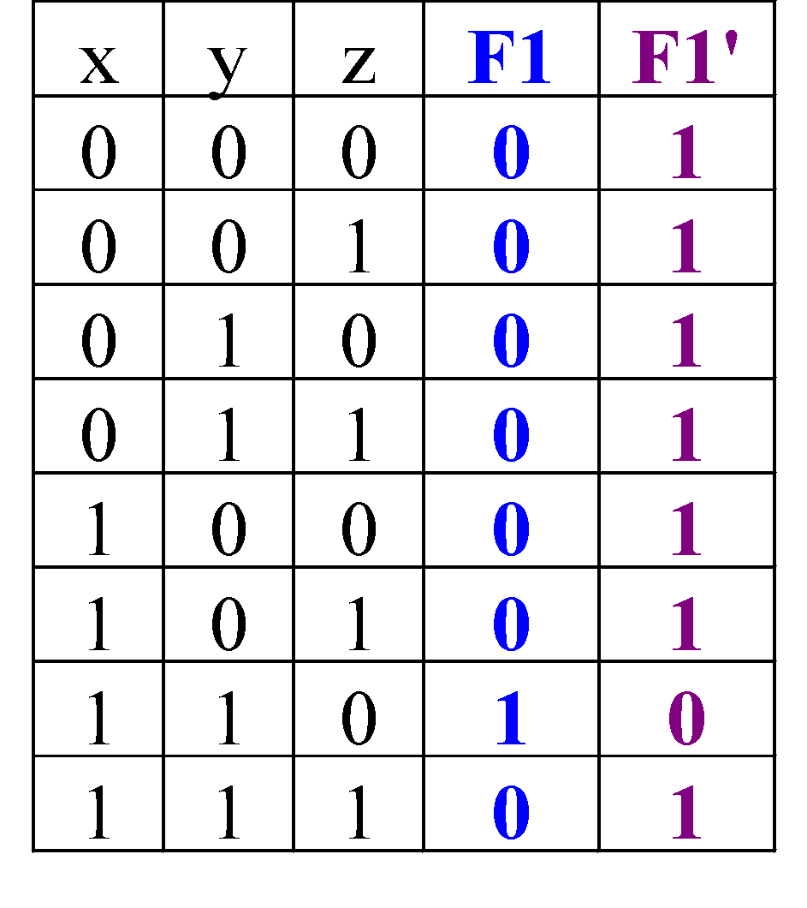
Complement of Functions[1]
Given a function, F, the complement of this function, F', is obtained by interchanging 1 with 0 in the function’s output values.
Example: F1 = xyz'
Complement:
F1' = (x.y.z')'
= x' + y' + (z')' De Morgan
= x' + y' + z Involution

Slide 15
Complement of Functions[1]
More general DeMorgan’s theorems useful for obtaining complement functions:
(A + B + C + ... + Z)' = A' . B' . C' … . Z'
(A . B . C ... . Z)' = A' + B' + C' + … + Z'

Slide 16
Example [2]
Find the dual of the following identities:
A.B +B.C+D.A
Ans : (A+B).(B+C).(D+A)
A+1 =1
Ans : A.0=0

Slide 17
Examples [1]
Simplify the following Boolean functions :
1. x(x’+y)
Ans : xy
2. x+x’y
Ans : x+y
3. (x+y)(x+y’)
Ans : x

Slide 18
Logic Gates[1,2,3]
Symbol set 1
Symbol set 2
(ANSI/IEEE Standard 91-1984)
Gate Symbols
a
b
a
b
&
AND
a.b
a.b
OR
a
b
a
b
≥1
a+b
a+b
NOT
a
a'
a
1
a'
a
b
a
b
&
NAND
(a.b)'
(a.b)'
a
b
a
b
≥1
NOR
(a+b)'
(a+b)'
EXCLUSIVE OR
a
b
a
b
=1
a ⊕ b
a ⊕ b

Slide 19
Logic Gates: The Inverter[1,3]
The Inverter
A
A'
A
A'
Application of the inverter: complement.
Binary number
1
1
0
1
0
0
0
1
0
0
1
0
1
1
1
0
1’s Complement

Slide 20
Logic Gates: The AND Gate[1,3]
The AND Gate
A
B
A
B
&
A.B
A.B

Slide 21
Logic Gates: The OR Gate[1,3]
The OR Gate
A
B
A
B
≥1
A+B
A+B

Slide 22
Logic Gates: The NAND Gate[1,3]
The NAND Gate
A
B
≡
A
B
(A.B)'
A
B
&
(A.B)'
(A.B)'
≡
NAND
Negative-OR

Slide 23
Logic Gates: The NOR Gate[1,3]
The NOR Gate
A
B
≡
A
B
(A+B)'
A
B
≥1
(A+B)'
(A+B)'
≡
NOR
Negative-AND

Slide 24
Logic Gates: The XOR Gate[1,3]
The XOR Gate
A
B
A
B
=1
A ⊕ B
A ⊕ B

Slide 25
Logic Gates: The XNOR Gate[1,3]
The XNOR Gate
A
B
A
B
=1
(A ⊕ B)'
(A ⊕ B)'

Slide 26
Drawing Logic Circuit
When a Boolean expression is provided, we can easily draw the logic circuit.
Examples:
(i) F1 = xyz' (note the use of a 3-input AND gate)
x
y
F1
z
z'

Slide 27
Drawing Logic Circuit
(ii) F2 = x + y'z (can assume that variables and their complements are available)
x
F2
y'
z
y'z
(iii) F3 = xy' + x'z
x
xy'
y'
F3
x'
z
x'z

Slide 28
Analysing Logic Circuit
When a logic circuit is provided, we can analyse the circuit to obtain the logic expression.
Example: What is the Boolean expression of F4?
A'
B'
C
A'B'
A'B'+C
(A'B'+C)'
F4
F4 = (A'B'+C)' = (A+B).C'

Slide 29
References
[1] M. Morris Mano and Michael D. Ciletti, “Digital Design with an Introduction to the Verilog HDL,” 5th Edition, Pearson Education,2013.
[2] Reshu Gupta, Amit Gupta ,Atul Kumar Sharma “ Switching Theory(Digital Electronics)”, Tech India Publication Series, Satya Prakashan, New Delhi.
[3] R. P. Jain, “Modern Digital Electronics,” 4th Edition, Tata McGraw-Hill Education, 2009.

